Slide 1
Vil AI gøre administrations- medarbejdere overflødige ?…
Jens Kaas Benner
Alexandra Instituttet A/S
Head of AI & Data Analytics, leder af Alexandra Instituttets København kontor
jens.benner@alexandra.dk
https://www.linkedin.com/in/jenskaasbenner/
+45 2091 1103

Slide 2


Slide 3
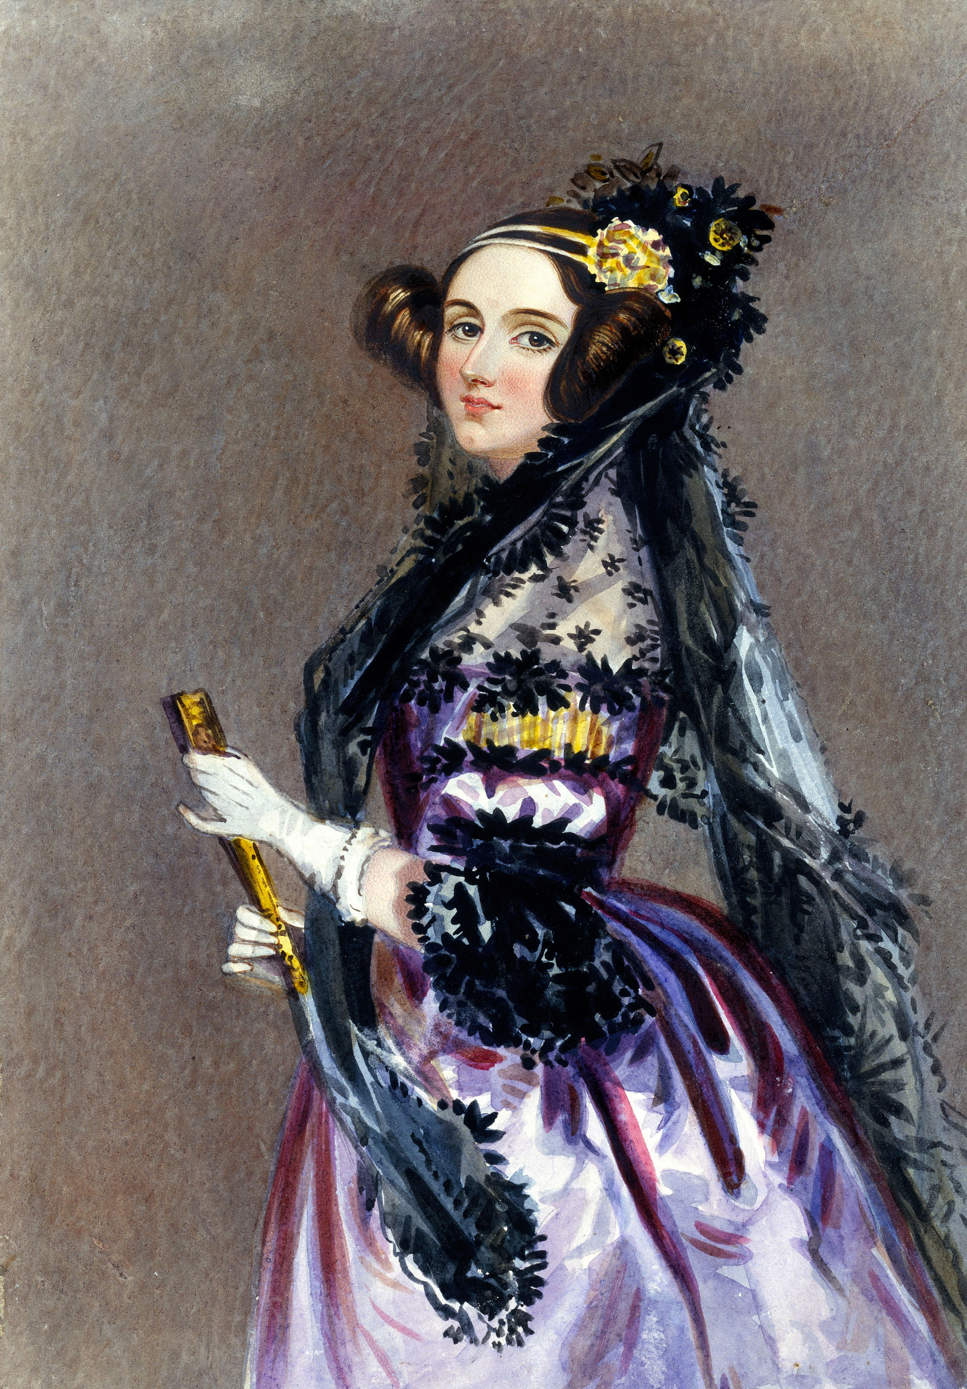
Verdens første computer programmør
Ada Lovelace
(1815 - 1852)
Notes:
Ada Lovelace er ”The Worlds First Tech Visionary !”
“Calculus of the Nervous System” was a phrase used by Ada Lovelace to describe her attempt to create a mathematical model for how nerve impulses give rise to thoughts and feelings in the brain. Ada, the daughter of Lord Byron, worked with Charles Babbage on his difference engine and was instrumental in documenting the construction of the engine. Howard’s composition, inspired by Lovelace, brings together many of her mathematical function composition techniques, as well as incorporating aspects of neural networks, and is constructed as a sequence of memories, some more clear than others, which overlap and interact: “like a muddled brain”.

Slide 4
”A calculus of the nervous system" (1844)
Notes:
Ada Lovelace er ”The Worlds First Tech Visionary !”
“Calculus of the Nervous System” was a phrase used by Ada Lovelace to describe her attempt to create a mathematical model for how nerve impulses give rise to thoughts and feelings in the brain. Ada, the daughter of Lord Byron, worked with Charles Babbage on his difference engine and was instrumental in documenting the construction of the engine. Howard’s composition, inspired by Lovelace, brings together many of her mathematical function composition techniques, as well as incorporating aspects of neural networks, and is constructed as a sequence of memories, some more clear than others, which overlap and interact: “like a muddled brain”.

Slide 5

AI skal automatisk finde den næste bestseller

Slide 6
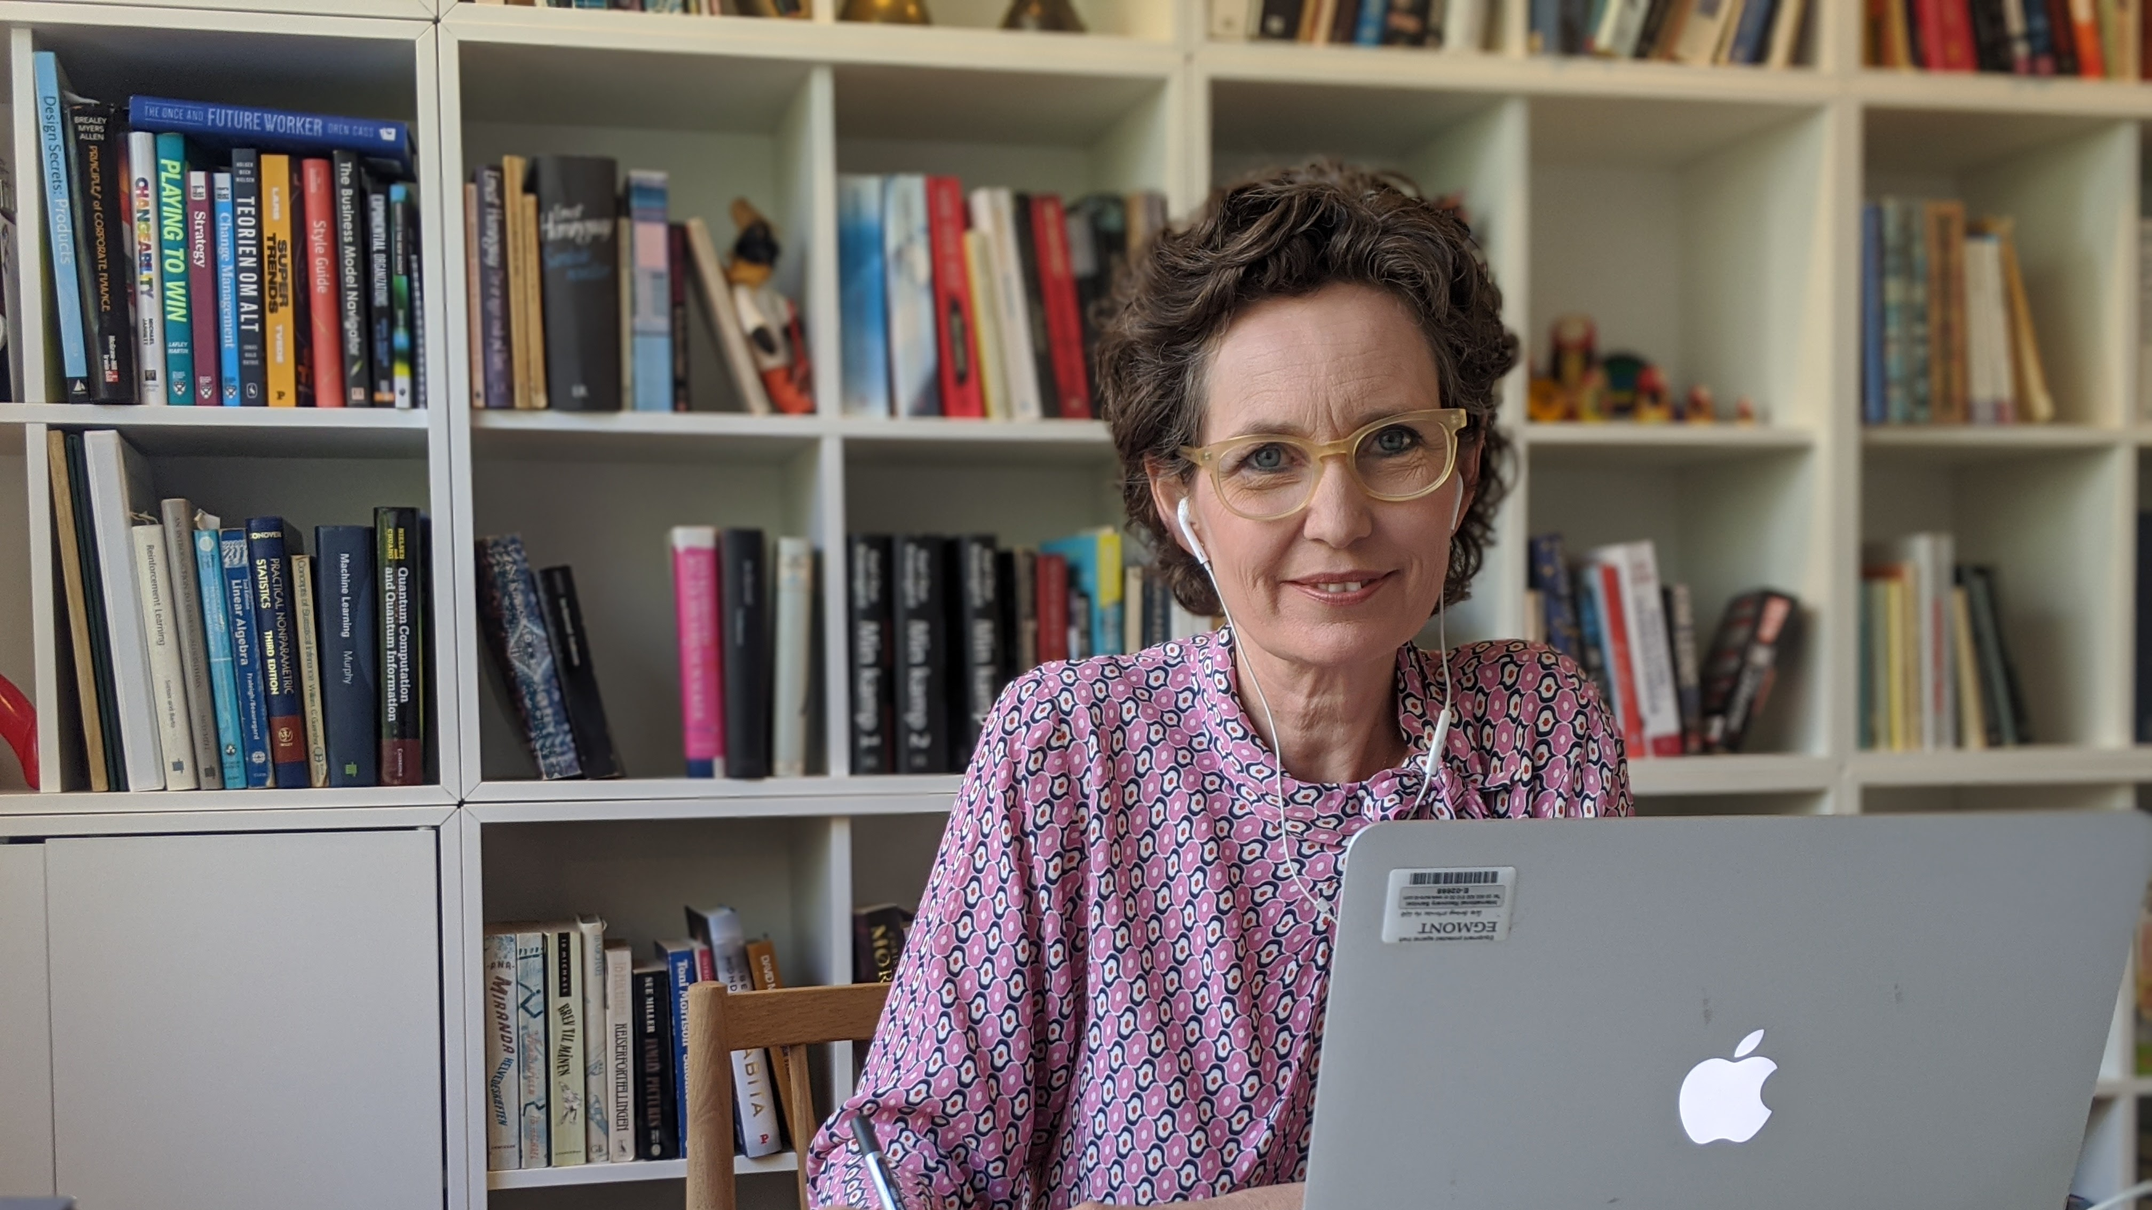
Billed af fruen !!!

Slide 7


Slide 8
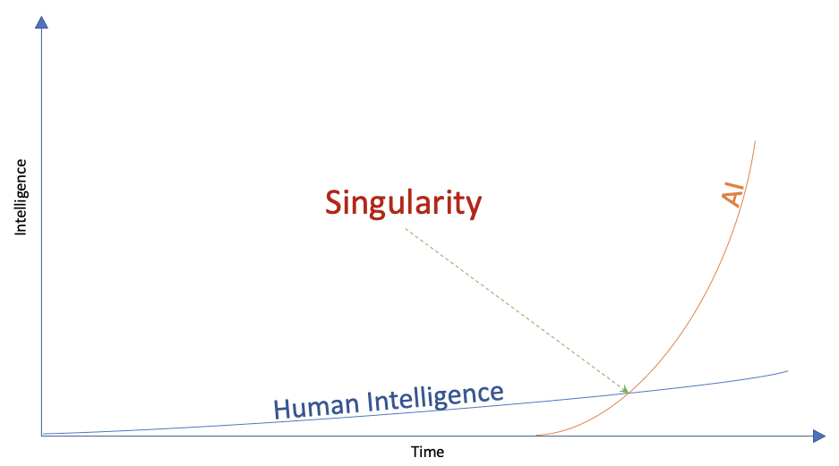
ALEXANDRA INSTITUTE

Slide 9
ALEXANDRA INSTITUTE

Slide 10


Slide 11


Slide 12
”
Den største bunke af opgavetyper er beskederne, medlemmerne skriver til os.
Vi bruger et helt årsværk bare på at sortere og omfordele post.
Peter Meleschko
IT-chef

Slide 14
”
Vi modtager 3,5 million opkald årligt fra borgere, og hver gang skal vi dokumentere hvad opkaldet handler om
Søren Christian Søndergaard Poulsen
Senior Director for Data & Analytics

Slide 15
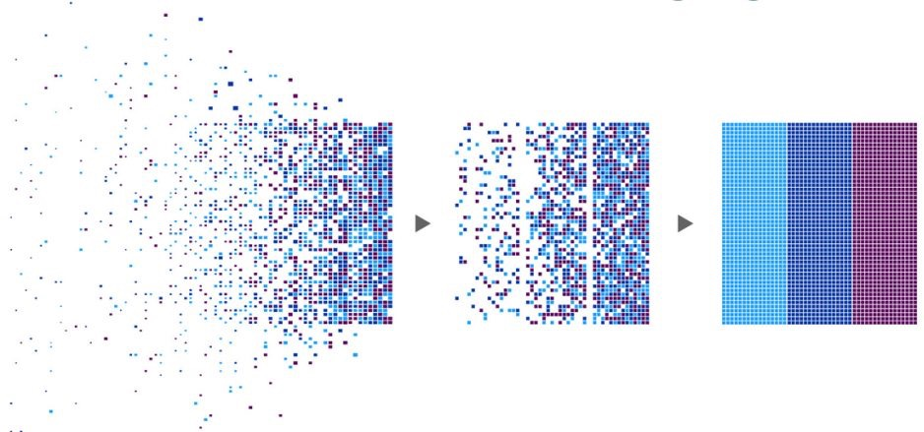
AI kan til at finde mønstre og sammenhænge i store datamængder

Slide 16
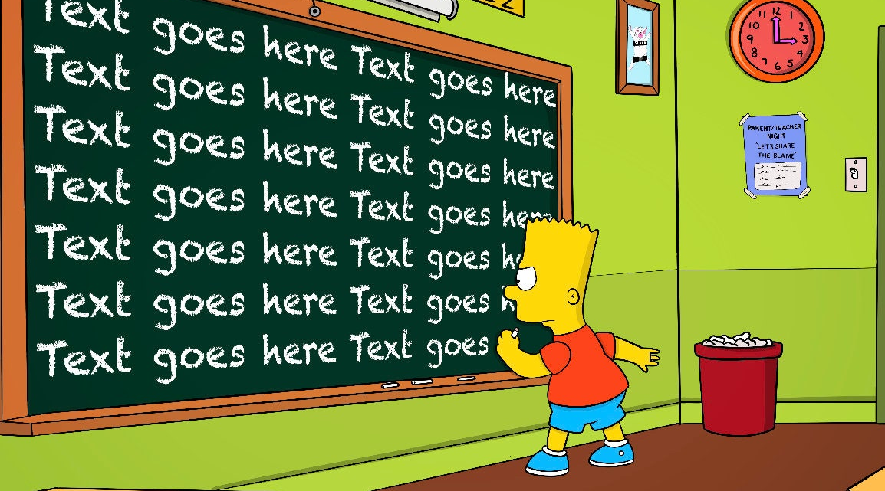

Slide 17


Slide 18
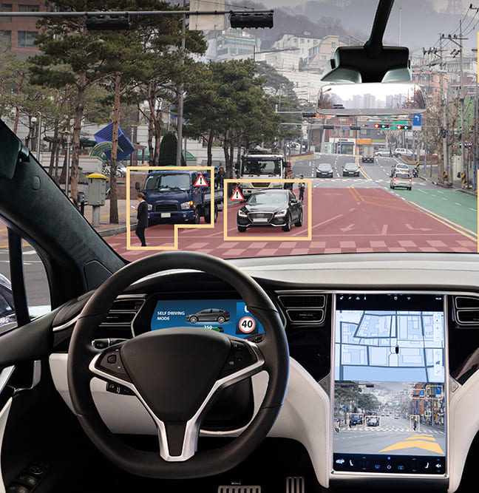

Slide 19
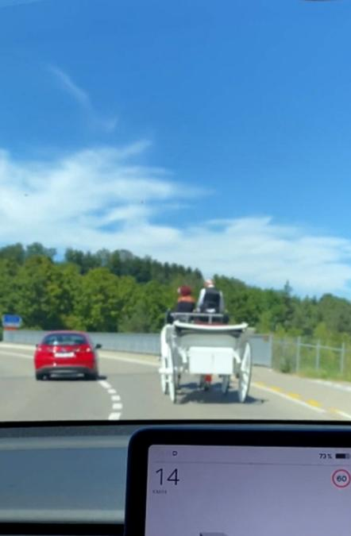

Slide 20
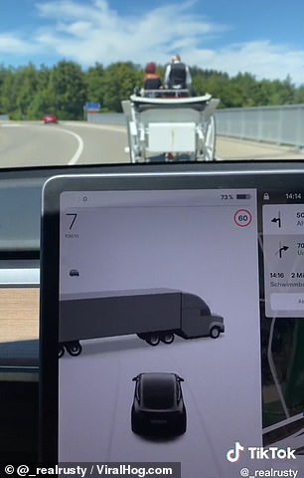

Slide 21


Slide 22
Prædiktions- maskine

Slide 23
87%

Slide 24

87%

Slide 26



87%

Slide 27


Slide 28
?
Vil AI gøre administrations- medarbejdere overflødige ?…

Slide 29
AI vil kunne automatisere nogle arbejdsgange fuldstændig …
JA

Slide 30
NEJ
AI vil i mange tilfælde være beslutnings-understøttende for domæne-eksperter

Slide 31

Vi hjælper jer foran digitalt
Som Godkendt Teknologiske Service-institut med fokus på it er vi sat i verden for at skabe vækst og velfærd med digitalisering
Jens Kaas Benner
Head of AI & Data Analytics,
Leder af Alexandra Instituttet i København
jens.benner@alexandra.dk
https://www.linkedin.com/in/jenskaasbenner/
+45 2091 1103

